Slide 1
GANimals
CS 455 Final Project
Daniel Khalil, Luke Crump, Vivian Dang

Slide 2
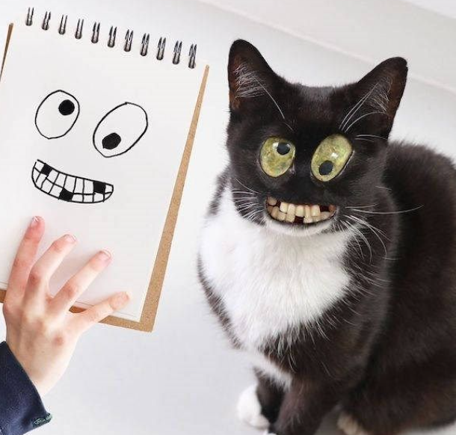
Overview of Challenge
There was a need for mass creation of monstrous animal faces.
Doing this traditionally, either by hand-drawing or photoshop, proved to be too time-consuming.
Thus, GANimals was born.

Slide 3
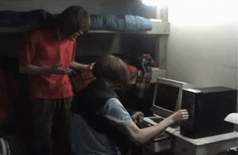
Limitations
Hardware
Most of our computers were not strong enough to handle generating the images.
Dataset
Kaggle dataset is limited to mammal faces only, but “GANmals” wasn’t as catchy.

Slide 4
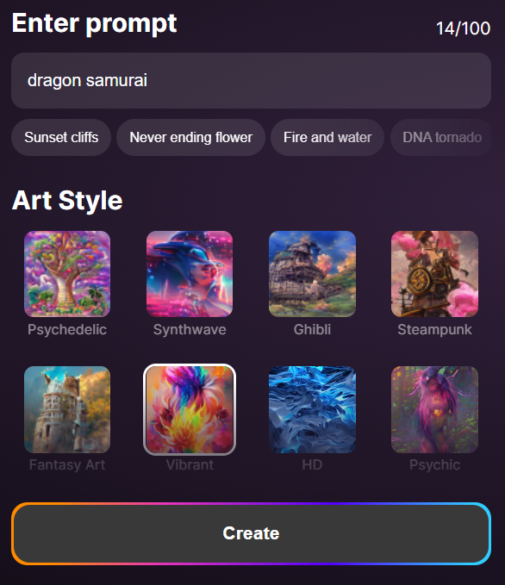
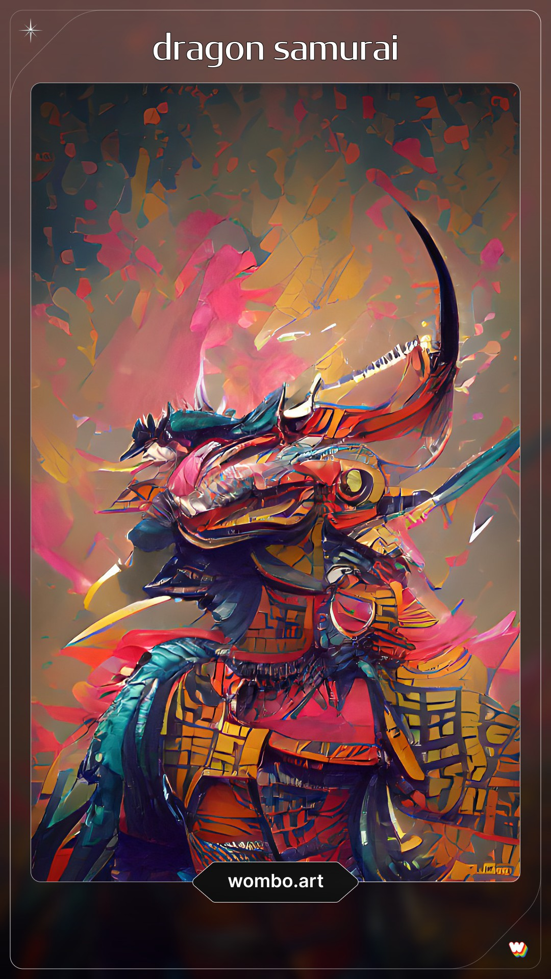
Approach
The images were generated using GANs, otherwise known as Generative Adversarial Networks.
There have been many other applications in art* that also utilize GANs.
*Ours is not this good.

Slide 5
Algorithm
Two neural networks:
Generator – creates fake sample
Discriminator – attempts to discern whether or not it is “real”
They are trained to compete against each other.
Random Input Vector
Generator NN
Generated Example
Real
Example
Update
Model
Discriminator NN
Update
Model
Real or Fake

Slide 6
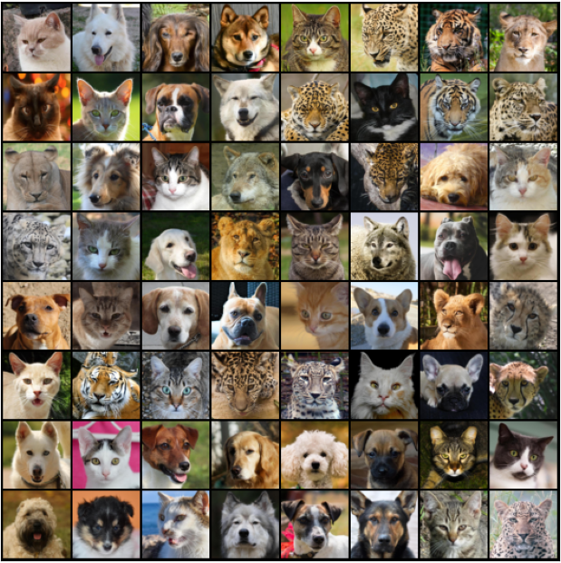
Key Resources
Kaggle Animal Faces Dataset which includes 16,130 high-quality images at 512×512 resolution.
The images were split into three categories:
Cats
Dogs
Wildlife

Slide 7
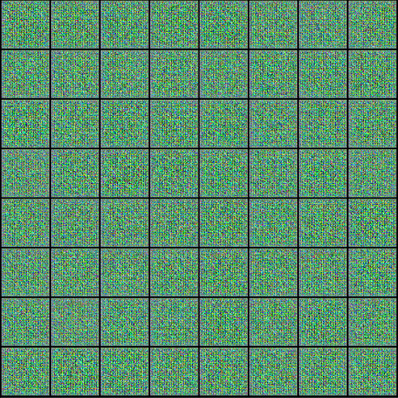
Solution
GENERATOR MODEL
Input is a matrix of random numbers (Latent Tensor)
Used as a seed for generating “fake” images
Convert Latent Tensor into an image using Transposed Convolution (a.k.a. Deconvolution) which is shown to the right

Slide 8
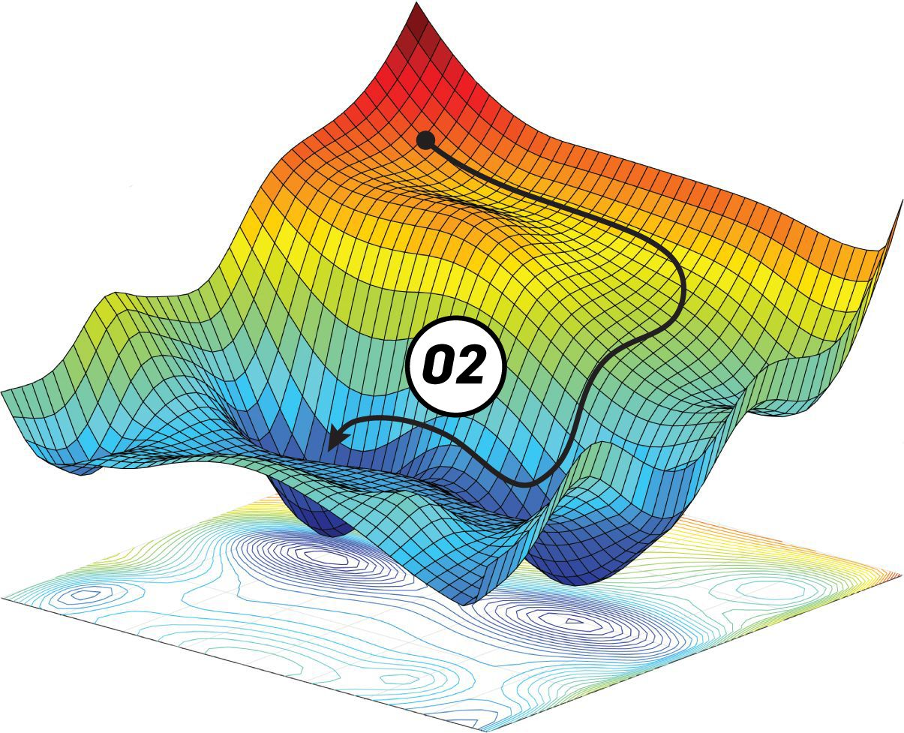
Solution
GENERATOR TRAINING
Generate a batch of images and then pass it to the discriminator.
Calculate the loss by setting the discriminator’s target labels to 1. (We’re trying to trick the discriminator.)
Use resulting loss to perform Gradient Descent to update the weights of the generator.

Slide 9
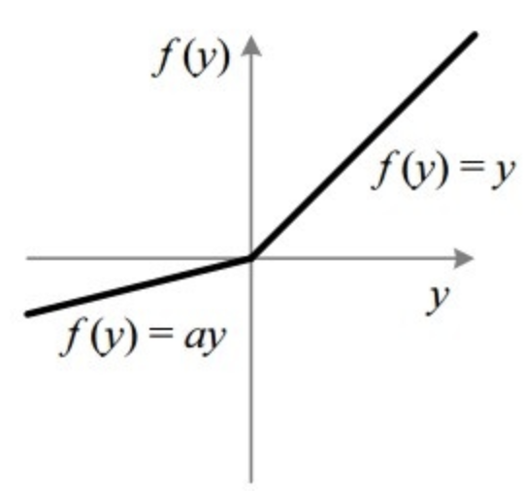
Solution
DISCRIMINATOR MODEL
Convolutional Neural Network
Outputs a single number per image between 0 and 1
Stride = 2
Input = 64 x 64 (Dataset was scaled down)
Activation Function: Leaky Rectified Linear Unit (Leaky ReLU) shown to right

Slide 10
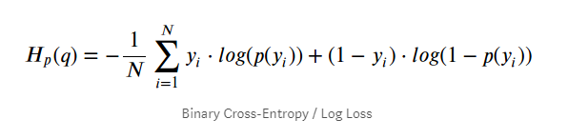
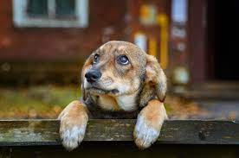
Solution
DISCRIMINATOR TRAINING
Loss Function = Binary Cross-Entropy
Pass a batch of real images, compute loss, and then set target labels to 1.
Pass a batch of generated images, compute loss, and then set target labels to 0.
Add the two losses and use overall loss to perform Gradient Descent to update the weights of the discriminator.
WOW. SUCH MATH.

Slide 11
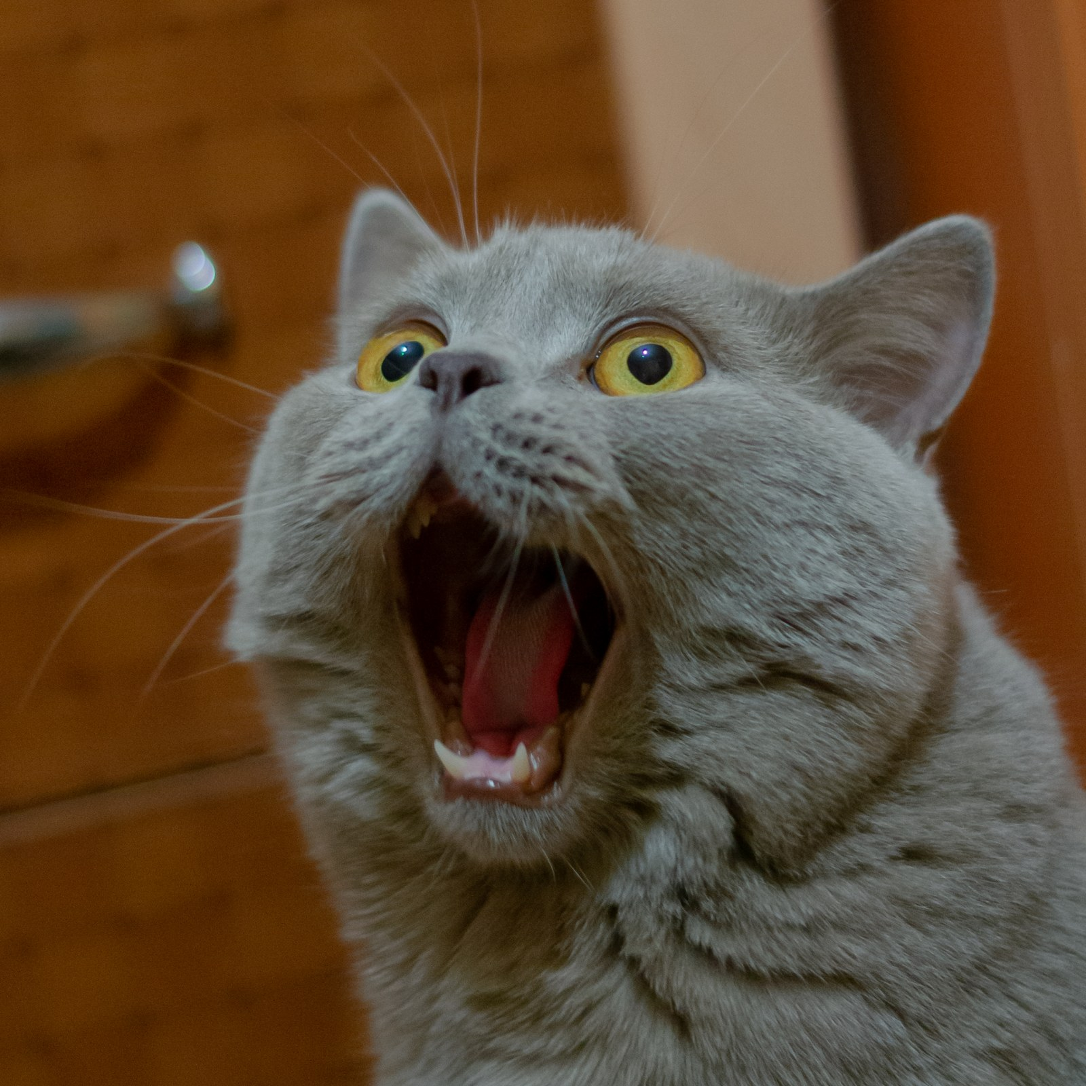
Demonstration
Due to limitations of hardware, a live demo was not viable.
However, we were able to generate up to 50 epochs before danger was imminent.
Please prepare yourselves for the following images.
PLEASE KEEP SCREAMS
TO A MINIMUM.

Slide 12
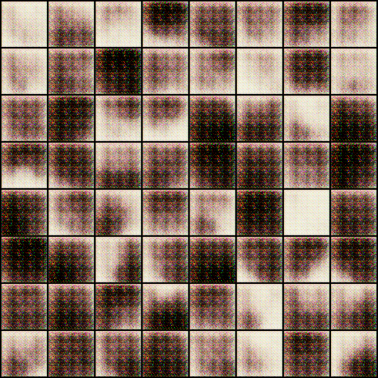
Demonstration
This is the first epoch that we generated.
As you can see, there’s not much to discern yet.

Slide 13
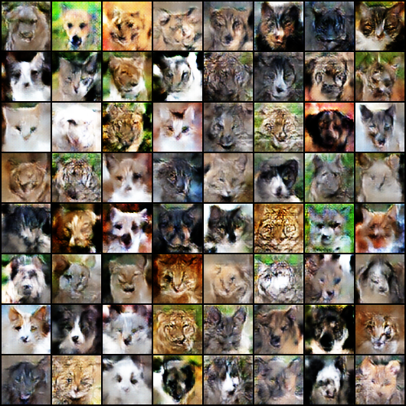
Demonstration
At 25 epochs, we’re really seeing some movement.

Slide 14
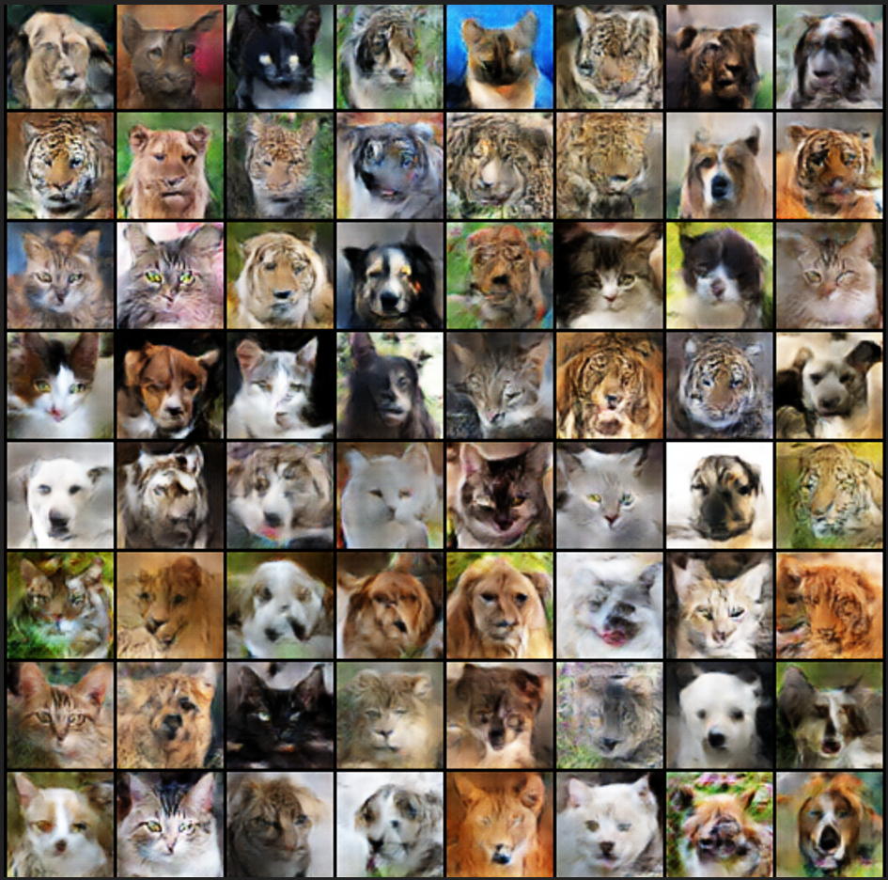
Demonstration
50 epochs in, and there isn’t really a noticeable difference between 25 epochs and this.

Slide 15
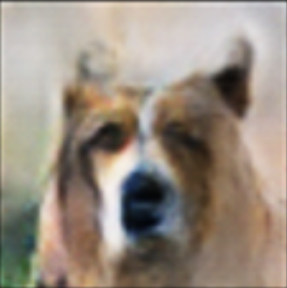
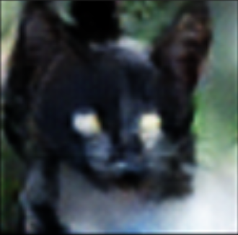
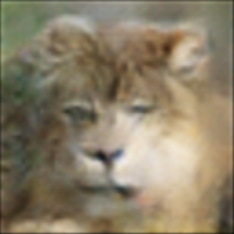
Demonstration

Slide 16
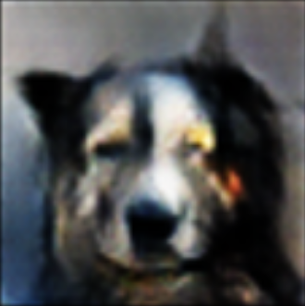
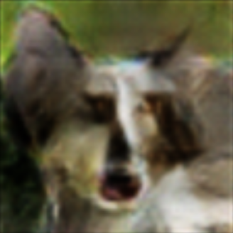
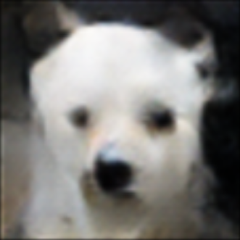
Demonstration

Slide 17
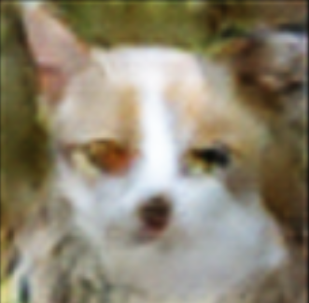
Conclusion
Overall, it seems like our call for the creation of monstrous animal faces was answered.
Operation GANimals was a success.

Slide 18
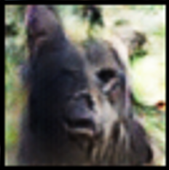
Thank You!
Any Questions?

